Slide 1
Open Identity for Open Government and the
Open Identity Exchange (OIX):
A Market Solution to Online Trust
June 2010

Slide 2
OIX is an Internet-scale solution to the problem of how open identity credentials can be trusted online

Slide 3
Background
OIX was founded by members of the OpenID Foundation (OIDF) and Information Card Foundation (ICF)
OIX was born of the US government’s need to accept identity credentials from certified providers at known levels of assurance
  The US government did not want to become an identity provider for all citizens
  Instead it wanted to consume credentials citizens already had from third-party identity providers

Slide 4
Third-party identity solutions
OpenID and Information Cards address the need for Internet-scale digital identity management
Both solve the problem using a third party to assist end-users in identity transactions
This sets up the following “trust triangle” for Internet identity transactions

Slide 5

The basic “trust triangle”
identity
service
provider
relying
party
Optional direct trust agreement
Terms of Service (TOS) agreement
Terms of Service (TOS) agreement
user

Slide 6
The trust problem
The user has a direct trust relationship with both the identity service provider and the relying party
The problem is: how can the identity service provider and relying party trust each other?
This problem is especially acute:
  At Internet scale, where identity providers and relying parties may not have any pre-existing relationship
  With high-value data like personally identifying information
  With high-assurance transactions

Slide 7
Direct trust agreements do not scale
Direct trust agreements are common when an identity service provider and a relying party are close business partners
  Airlines and rental car companies
They do not scale to large networks, e.g., credit card networks, ATM networks
  Requires n² trust agreements
The solution is often a trust framework
  A shared set of policies and agreements

Slide 8

A trust framework “umbrella”
Trust
Framework
identity
service
provider
relying
party
user
Trust Community

Slide 9
Trust framework providers
Other industries (credit cards, ATMs) have created global trust frameworks
They each use a shared trust framework provider
  Visa, Mastercard, AMEX
  Cirrus, PLUS
The same model can be used for digital identity assurance

Slide 10
The US government vision
Create a program for approving industry non-profits as “trust framework providers” (TFPs)
  US ICAM TFP Adoption Process (TFPAP)
  (http://www.idmanagement.gov)
These TFPs in turn certify private industry identity providers against the requirements for different level of assurance (LOA)
  TFPAP covers LOA 1 through 4 based on the NIST 800-63 standard

Slide 11
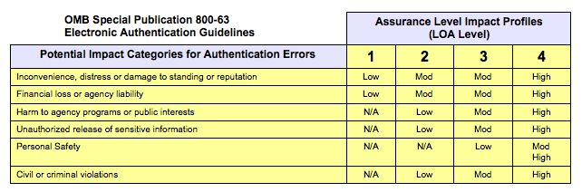

Trust Framework becomes scalable "architecture" for trusted services
"Citizen-facing" Missions
(Agencies as "Service Providers")
Identity Providers (IDPs)
(Personal Data Store Providers)
Google, Yahoo, Facebook, Citi, Paypal, Verisign
Federal Trust Framework Model
(OMB 800-63; eAuthentication; HSPD-12)
Relying Parties (RPs)
(Trusted Service Providers)
Users
Government
Banks
Hospitals, etc
"Trust Network"
Service Providers define "Identity Scheme" to support services in Trust Network model (ISAP)
Service Providers and Identity Providers propose model to support services (TFPAP)
Users "join" in Trust Networks, learning new security/control model in "context" of service
Level 1 Framework allow "individualized interaction" without Personally Identifiable Information
Services to be defined at Levels 2-4 can be added "incrementally" and in context

Slide 12
Timeline for creation of OIX
Nov
2009
May
2010
Dec
Jan
Feb
Mar
Apr
OIDF/ICF Joint Steering Committee formed to review options for meeting TFPAP goals
JSC recom-mends formation of OIX
Final
approval received from both boards
OIX launched at RSA
Approved as TFP by US ICAM
First 3 IdPs certified
Open Identity Trust
Framework Model
paper published
Expanded member-ship docs approved; working groups commence

Slide 13
Industry vision
Industry wanted to solve the problem of identity credential trust not just for the US government, but for any trust community
So it created the Open Identity Trust Framework Model
  Published jointly by OIDF, ICF, and OIX
  Allows any trust community to create their own trust framework specification (TF)
  Each TF “plugs in” to the OIX certification program

Slide 14
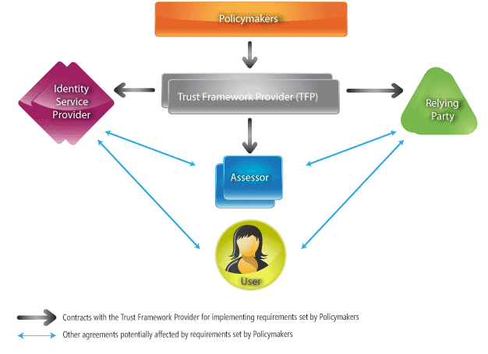
The OITF Model
Levels of
Assurance
Levels of
Protection

Slide 15
The US ICAM Trust Framework
First official OIX trust framework
Approved by ICAM on 2 March 2010
Currently operates at LOA 1
Google, PayPal, Equifax, and Verisign certified; more in process
Application for LOA 2 and 3 in development
  US ICAM Trust Framework Working Group

Slide 16
Other OIX trust frameworks in development
Line Information Database (LIDB)
  To safeguard access to telco subscriber data
PBS Public Media
  To connect public TV stations, users, and sites
XAuth
  To simplify movement between social sites
PDX (Personal Data Exchange)
  To support individuals sharing data on their terms

Slide 17
OIX Working Groups
Lightweight process designed to support all aspects of trust framework development
Open to OIX members and non-members
Encourages information sharing and best practices
Two general WGs:
  Legal WG
  Trust Framework Development WG

Slide 18
Legal WG
Develop TF Process and Structure
  Work with Trust Communities to build TFs and standardize TF design
  Target legal rule “best practices”
Developing an “ecosystem of obligations” analytical structure
Will collaborate and coordinate with related legal standardization initiatives

Slide 19
Trust Framework Development WG
Publish OIX Trust Framework Requirements and Guidelines document
  Step-by-step template for an OITF-compliant trust framework
Hosts governmental TF best practices discussions/workshops
Incubates new TFs – assists policymakers with education and early requirements analysis

Slide 20
OIX Listing Service
Web service to be hosted by OIX on behalf of all the participants
  Both human-readable and machine-readable
Will describe what organizations are participating in what trust frameworks at what LOA and LOP using what Technical Profiles
Will provide an efficient, near-real time market information feedback loop
Can be queried by IdPs, RPs, and user agents

Slide 21
OIX membership
 | Commercial (>50 employees) | Commercial (<50 employees) | Government | Academic/Non-Profit
Executive Member | $25,000 | $25,000 | $25,000 | $25,000
General Member | $5,000 | $500 | $1000 | $500
Professional Service Provider | $5,000 | $500 | $1000 | $500
Trust Framework Authority | $5,000 | $500 | $2500 | $500

Slide 22
QUESTIONS/DISCUSSION

Slide 23
Great opportunity to align forces to accelerate government mission results
Lower Risk
Lower Cost
Improved mission effectiveness
Improved transparency
Improved citizen access to government services
Improved "citizen experience" across government websites

Slide 24
Leadership and key government initiatives are a driving force
Task Force on Identity Management provides focus and vision
CIO Council establishes Identity, Credentials and Access Management Subcommittee (ICAM)
ICAM consolidates efforts: eAuthentication; OMB 800-63; HSPD-12
  Evolves "federation" model to define process for adopting "Trust Frameworks" (TFPAP)
  Creates framework for developing underlying "Identity Schemes" (ISAP)
  Establishes OMB Levels of Assurance model as cornerstone for ISAP/TFPAP
  Adopts us of "Industry" technology to allow "lightweight" implementation
  Reconciles specifications (OpenID and Information Cards) to OMB 800-63
  Establishes first Trust Framework, referred to as the "Level 1 Trust Framework"
Industry embraces Trust Framework model and works to support "Level 1 Communities"

Slide 25
Industry supports Federal efforts to improve "Service Delivery"
Industry recognized superiority of "lightweight federation" several years ago
  Microsoft develops "Card Space" technology to support rich identity technology
  Microsoft "contributes" technology to enable open source "Information Card" technology
  Identity "community" consolidates on OpenID as lightweight URL-based identifier
  OpenID and Information Card groups form foundations for joint market development

Slide 26
Industry supports Federal efforts to improve "Service Delivery"
Industry begins to embrace lightweight federation model
  Microsoft supports OpenID and works to help develop "seamless" user experience
  AOL, Google, Facebook, Yahoo, VeriSign, JanRain, and others support OpenID
    Current estimates on OpenIDs exceed 1 Billion, with 40,000 sites supporting
Industry supports Federal Government as the largest "Service Provider"
  500 citizen-facing sites, with massive relevance to existing OpenID "customer base"
  Opportunity to increase transparency, access, and experience with Level 1 Communities

Slide 27
Trust Framework becomes scalable "architecture" for trusted services
"Citizen-facing" Missions
(Agencies as "Service Providers")
Identity Providers (IDPs)
(Personal Data Store Providers)
Google, Yahoo, Facebook, Citi, Paypal, Verisign
Federal Trust Framework Model
(OMB 800-63; eAuthentication; HSPD-12)
Relying Parties (RPs)
(Trusted Service Providers)
Users
Government
Banks
Hospitals, etc
"Trust Network"
Service Providers define "Identity Scheme" to support services in Trust Network model (ISAP)
Service Providers and Identity Providers propose model to support services (TFPAP)
Users "join" in Trust Networks, learning new security/control model in "context" of service
Level 1 Framework allow "individualized interaction" without Personally Identifiable Information
Services to be defined at Levels 2-4 can be added "incrementally" and in context

Slide 28
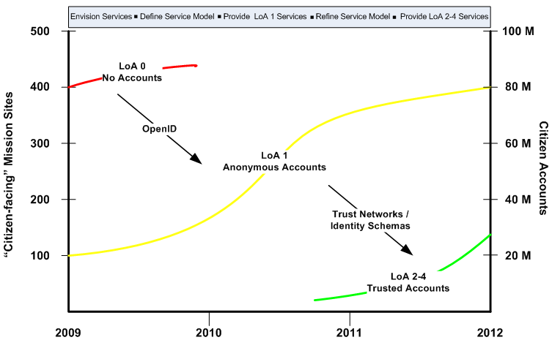
Level 1 Services create Tipping Point for Trust Frameworks

Slide 29
Roadmap To Success For Near-Term Goals and Long-Term Needs
Opportunity to leverage "mass market" forces to significantly improve security & performance
  Move to "Trust Framework" model by achieving Tipping Point with Level 1 services
  Move to "Trusted Services" as new Trust Frameworks proposed at Levels 2-4
Claim victory for transparency, access, and service with adoption of Level 1 Communities
  Align with current Agency efforts using "publication" sites, to define "communities"
  Look for "early winners" to build momentum across 500 citizen-facing sites
  Track creation of "citizen accounts," leveraging OpenID technology across all sites

Slide 30
Roadmap To Success For Near-Term Goals and Long-Term Needs
Initiate the serious work needed to achieve success with incremental Level 2-4 services
  New teams to focus on issues in the Public/Private balance of privacy and security
  Immediate focus on "user experience" to support seamless evolution for citizen security
  Working groups to seek "normalization" of user-facing security technology for Levels 2-4

